Slide 1
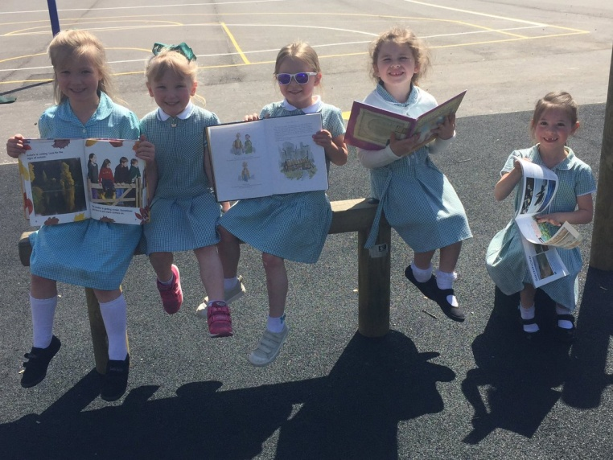
St Nicholas’ Primary School
7^{t} June 2022
6.30pm
Notes:
Welcome

Slide 2
Aims for tonight...
To provide parents with some general information and practical advice about starting Primary 1.

Slide 3
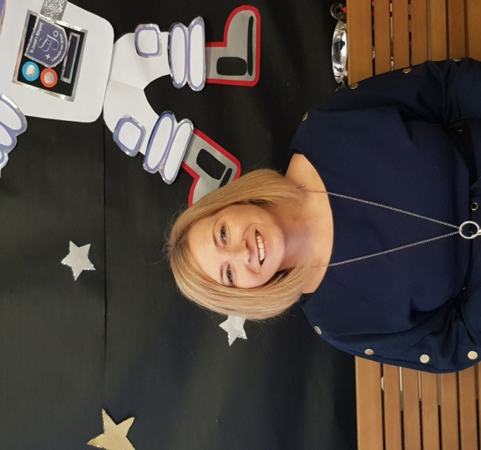
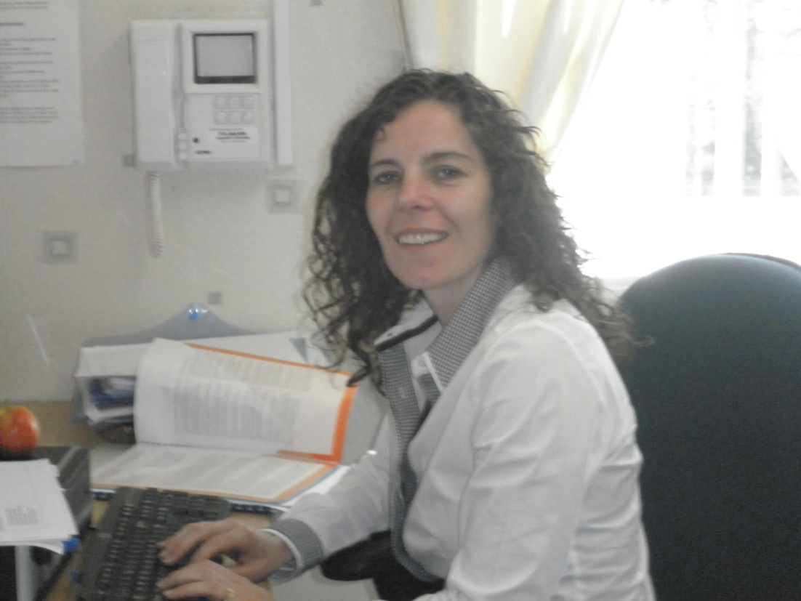
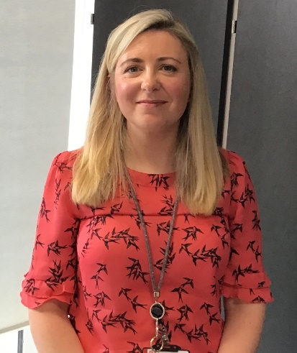
Senior Management Team
Depute Head (P1-4)
Mrs Angela Murray
Depute Head (P4-7)
Miss Carol Lennon
Head Teacher
Mrs Charlotte Grogan.

Slide 4
Parish Support
As a Catholic School we value our links with the parishes of St Andrew’s in Bearsden and St. Joseph’s in Milngavie.
Notes:
The Parish Priests Father Mackle (St Andrew’s Parish, Bearsden) and Father Currie (St Joseph’s Parish, Milngavie) offer us great support in holding Mass in the school on Holydays of Obligation.
We also have a yearly calendar of prayer services and special services to which you are most welcome to attend.

Slide 5
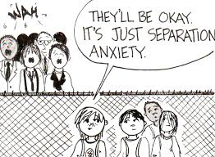
First Day
Wednesday 17th August 2022
Wednesday 17th - Friday 19th August
Start Time – 9.30 am
Pick up Time - 2.30 pm

Slide 6
Normal School Hours
9.00am-3.00pm (P1 Gate open at 8.50am)
Morning Break 10.30-10.45am
Lunch time 12.15 -1.00pm
Notes:
.

Slide 7
School Drop off
Please drop your child at the gate of the small playground.
For Health and Safety reasons no adults are permitted in the playground.
Children enter the playground from 8.50am and go straight to class at 8.55am.

Slide 8
School Pick Up
The children will be brought to the playground gate by their teacher at 3pm.
Notes:
When collecting your child please stand well back from the gate to enable the class teacher to see all adults, as the children will only be allowed to go when parents and carers can be seen.

Slide 9
School Holidays
School Holidays are available on EDC website.
Please click here to access them.

Slide 10
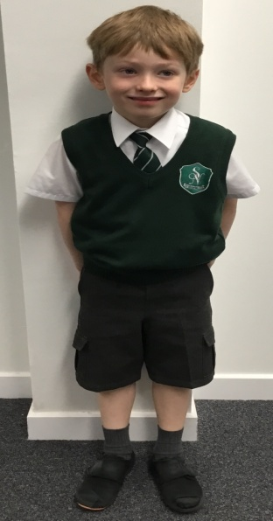
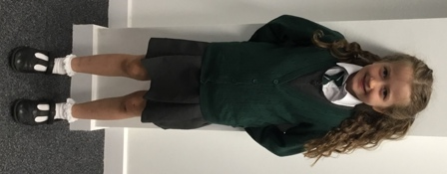
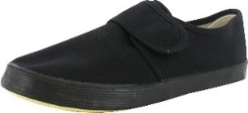
School Uniform
Grey trousers, shorts, skirt or pinafore
White shirt, blouse and school tie or polo shirt
Green jumper, sweatshirt or cardigan
School jacket or blazer
Indoor shoes
Notes:
Information was sent out in previous emails re where to purchase. There is also a uniform fashion video on the thing link on the school website.
The children will also need a pair of indoor sandshoes/plimsoles which should be left in school.
Sandshoes with elasticated fronts or Velcro fasteners are the easiest for your child to put on and take off by themselves.
The children will change into their indoor shoes when they come in in the morning
We won’t ask them to do this on the first day

Slide 11
P.E. Kit
White t-shirt or white polo shirt (with or without school badge)
Green jumper/ sweatshirt (with or without school badge)
Black, grey or green shorts/jogging trousers/leggings/gym skirt
Trainers/Sandshoes - Pupils may wear their indoor shoes as long as they have non marking soles.
Jewellery Policy – All jewellery must be removed for PE.
Notes:
Pupils will need a school PE kit for gym days. They will receive 2 hours PE every week – usually 2 sessions.
Teachers will advise what days gym is on.
In consultation with our Parent Body, we have decided that our children can come to school on PE days in their PE uniform. Please note that this does not take away the opportunity for children to come to school in their school uniform and change into their PE kit.
The PE uniform comprises of . . .
Jewellery Policy - For Health & Safety reasons - All jewellery must be removed for P.E. lessons.
EDC Policy - If your child is unable to remove their own earrings, they will not be able to participate in PE.
Parent’s might consider removing their child’s earrings before they come to school.
If your child is keen to get their ears pierced, please organise this for the summer holidays to allow them to heal before the start of the session.

Slide 12
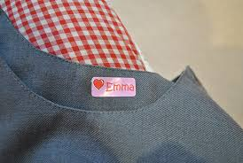
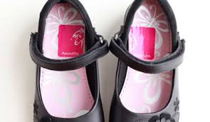
School Uniform - please label EVERYTHING!
And we mean everything!
Notes:
Everything Indoor shoes, hats, water bottles etc.
You will be amazed at the uniform that gets lost – if there are no labels, it is very difficult to get items back to the right person!

Slide 13
What will your child need on the first day?
A school bag
A bottle of water
A small healthy snack
Pencil case (optional, but the children often like to have one)

Slide 14
Intervals
Snacks (Nut Free)
Adult Supervision
Wet Weather
Notes:
.Snacks – Small healthy snack, perhaps one drink and one item at the most.
Nut Free Zone
Safety – no lollipops, glass bottles or cans.
There is adult supervision in the playground – The P1 children will be in them playground by themselves at least until October.
Wet Weather – Children will go out to play if very light rain, so it is important for children to have a jacket at school.
During very wet weather, the children remain indoors supervised by support staff and hopefully P7 monitors.

Slide 15
Lunch
Free school lunch
School Lunch
Packed Lunch
Lunch Supervision
Notes:
P1-5 are entitled to a free school meal.
The school will email you a copy of the lunch menu as soon as they are made available to us. More information is available on the EDC website.
Children can bring their own packed lunch with them – try not to pack too much. We want to make sure they have time to play too.
The children are supervised in the lunch hall.

Slide 16
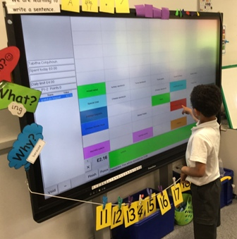
Lunch – Self Registration
Children can either order their own lunch on the whiteboard in class or they can order at home.
Home ordering will not be available until children start school and relevant paperwork has been completed.
Notes:
Each day the teacher will let the children know what the choices for lunch are and they will be helped to choose the school lunch they want.
Children can either order their own lunch on the whiteboard in class or they can order at home.
**They will not be able to order at home immediately.
Once the children start school and are officially on our system, you will receive a letter from the office with information about the i-pay system –where pupils can order and pay for lunch. The letter will provide you with log in details and instructions regarding how to log in, order etc.
In the future, children may be given a coloured band depending on what option they chose. This helps catering and school staff make sure they get the dinner they ordered.
It would really help if parents discussed lunch choices each morning before coming to school.
You will get an opportunity to experience a school lunch tomorrow- many of you have signed up for this – come to front entrance at ……

Slide 17
P1 Homework
Phonics
Sight vocabulary
Reading – Bug Club – online reading scheme
Numeracy/Maths websites – Sumdog, studyladder
Notes:
P1 homework normally consists of
You can help by . . .
Regular, short reinforcement sessions with your child
Choose a time that you will get the best out of your child.
Give lots of praise and positive reinforcement
If your child is finding something really hard or getting
upset, stop and try again at another time.
Practise, Practise, Practise! - Phonics and sight vocabulary
I will sent out a curriculum information booklet which also provides some practical advice about how to support with some aspects of literacy and numeracy – more will follow when we do a curriculum information session when your child is at school.

Slide 18
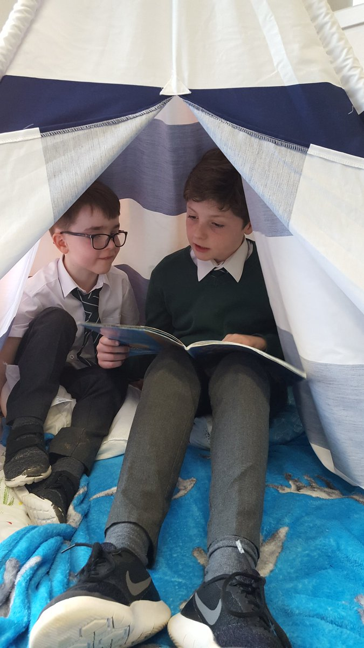
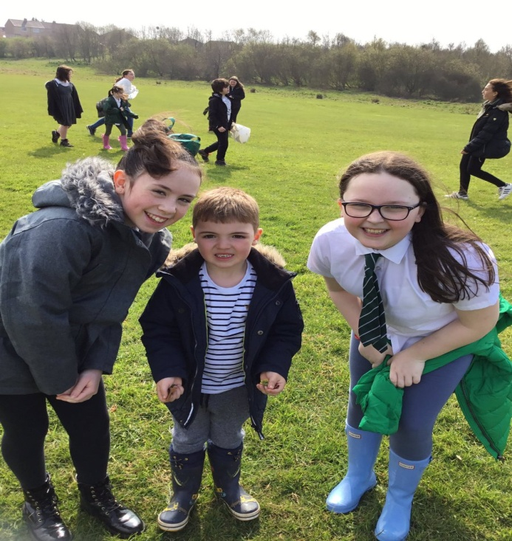
Buddies
Notes:
All children have been allocated a buddy from Primary 7. They will probably have 2 – one from each P7 class.
We are looking forward to next year when the children can have more time to physically meet with their buddies.
Buddies will have
planned times in the playground with them – looking to have at least once per week.
The buddies are also used to support the P1 children at different times of the year – Wellie walks, Shared Reading, ICT, technology etc – aiming for twice a month – once for each of the buddies.

Slide 19
Communication
Groupcall- email/text
Letters
See Saw/ School Website
Twitter @NicholasPrimary
Notes:
E-mail
Email and text via group call are the main form of communication used by the school.
Please check your email regularly and if you make any changes to your email address, please inform the school as soon as possible
Letters –still occasional letter drops particularly at start of term.
Annual data, ev3 consent forms for trips, permission forms, any trip information.
Please regularly check your child’s bag for letters.
This is especially important if your child is the only little person from your house coming to school.
Twitter/School Website
Class Teachers share what is happening in class via see saw which you can only access as family members. You will only be able to see your own child’s work, but the teacher will also share photos of some class work with everyone.
We have also embedded a see saw blog into our school website –this means that we can share some of our great work to a wider audience – your child’s picture will only be here if we have the correct permissions.
We use twitter to share whole school information and photos.
Our Twitter is a closed group, please request to join.
Our twitter address is Twitter @NicholasPrimary

Slide 20
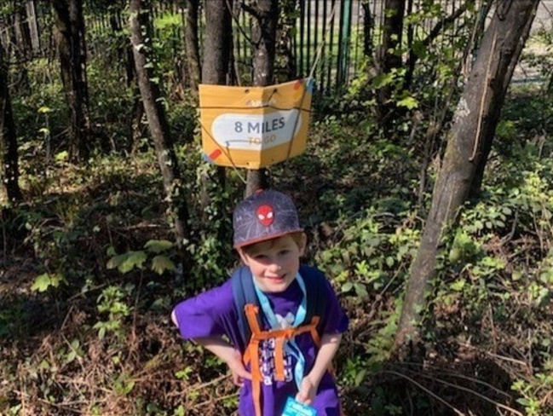
Wider School Achievements
Encourage your child to tell their teacher(s) about their achievements so that it can be shared in class and at the monthly achievement assembly.
Encourage your child to bring in their medals, trophies or certificates to help them talk about their achievements.
Email a photograph/blurb into school with the subject Wider Achievement.
Notes:
At St Nicholas, we are aware of how important it is to recognise and support the children’s achievements.
We want our children to value and be proud of what they learn out with the classroom, as well as in it.
We recognise and celebrate these achievements in many ways, including: assemblies, certificates, displays, posting on Seesaw, class reward systems, class shout outs, Truly Trusted awards (linked to Gospel values) and the Spirit of St Nicholas Award at the end of P7.
We also share wider achievements via a see saw blog on our school website.
You can help by . . .
This is a wee boy in P2 who took part in The Big Stroll of the Glasgow Kiltwalk. He walked 14.4miles from Clydebank to Balloch in 6 hours and raised £600 for the Glasgow Children's Hospital Charity.

Slide 21
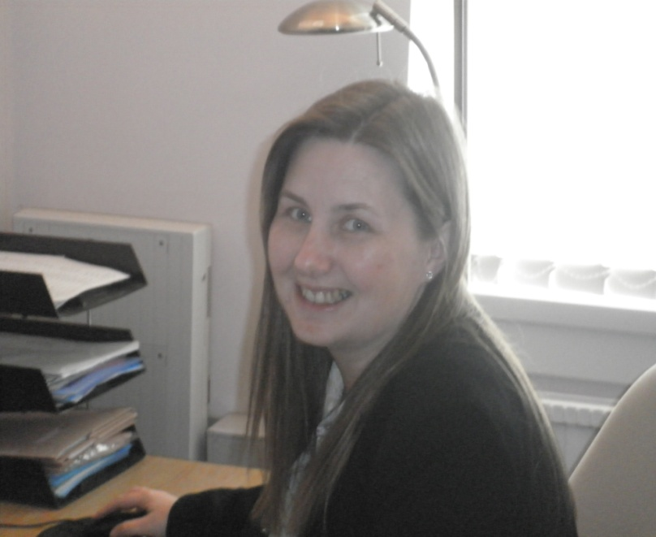
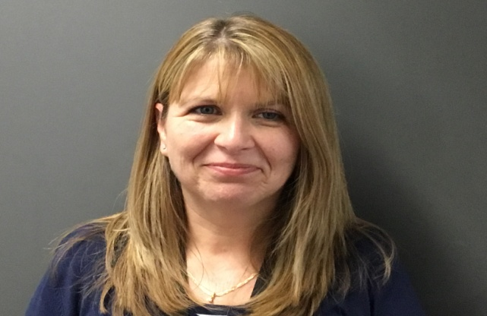
Office Staff Ms MacPherson Mrs Murray Mrs Gartshore

Slide 22
School Office
Safety and Security: all parents must report to the school office
Messages for teachers should be passed through the school office
Phone the office if your child is going to be late or you are going to be late picking your child up.
Circumstances change: Inform the office if there is any changes to your details/circumstances.

Slide 23
Useful Information
What if my child is absent from school?
If your child is unable to attend school, please telephone the school on Day 1 as soon as possible.
If the absence continues, please keep us informed.
Notes:
EDC Policy – Ensures the safety of pupils
Contact parents of absent children if we had not been notified of an absence
followed by the emergency contacts,
followed by attendance officer and
finally the police if there is no contact made

Slide 24
Useful Information
What if my child has a medical problem?
Please speak to the school about any aspect of your child’s health which may concern you.
If your child requires medication to be administered in school, then you must complete the relevant forms.
Please do not send your child in with medicine and a note of instructions as the medication cannot be administered until appropriate forms are completed.

Slide 25
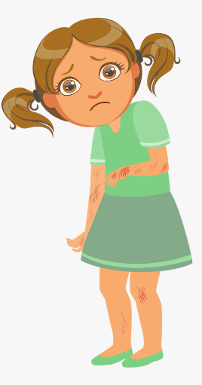
Useful Information
What happens if my child takes ill at school?
We will contact you.
If we cannot contact you, we will contact your emergency contact.
.
Notes:
. Please keep all phone numbers given to the school up to date, particularly mobile telephone numbers.
If your child is unwell they should not attend school. In cases involving sickness and/or diarrhea, children should be kept at home for 48 hours after the symptoms have stopped.

Slide 26
School Buses
Eligibility
Changes to bus schedule
Bus Procedures
Notes:
To be entitled to free school transport, you must live one mile or more by the shortest safe walking route from your catchment area primary school.
If you are eligible, please obtain an application form from the school office or the EDC Website.
Some P1 parents choose to phase their children on the bus and don’t use the bus service in the first few days – this is a parental choice.
If your child is going to be using the bus in the first few days – please put a note of this in writing to the office.
A letter will go out early on in the session to ask which days your child will be using the bus – this information will then be collated by office staff and will be used to ensure everyone who should be on the bus on certain days is on the bus.
It is very important that if there are any changes to the information you provide us with regards to the bus days – please contact the school asap. Please try not to leave it until near 3pm. If you have regular changes, contact the office as and when or give a note to the
class teacher.
The children are met off of the bus by an adult in the morning and directed off into the playground where there is a staff member supervising. At the end of the day, the children gather in the hall and will be escorted to the bus.
The driver is the only adult on the bus.

Slide 27
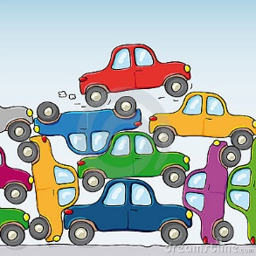
Parking
In the interest of safety
NO PARKING
is permitted in the bus bay, the school car park or school driveway.

Slide 28
How can you help get your child ready for school?
Talk to your child positively about school
Discuss the school day – what to expect
Revisit videos on school website
Encourage independence – changing clothes, shoes
and coats, packing bags, toilet, cutlery, tidying up,
Help them to learn to put coats/jackets on a hangar.
Practise turn taking, sharing, focussing on a game
or task
Notes:
I will send out a curriculum information booklet which also provides some practical advice about how to support with some aspects of literacy and numeracy – more will follow when we do a curriculum information session when your child is at school.

Slide 29
Class for August 2022
There will be one Primary One class in August with 2 class teachers.
Class Teachers will be confirmed on last stay and play visit to the school.
Notes:
Mrs Grogan will talk to you about this.

Slide 30
Any Questions?
Notes:
Look forward to seeing some of you tomorrow for lunch experience – 11.30
Next week will be the final stay and play session – Teddy Bear’s Picnic (Meet Teachers) usual time 1.45-2.30pm. Bring their teddy.
After next weeks session I will post a link to an evaluation form which I would really appreciate if you take the time to fill in – should only take a few minutes.

