Slide 1
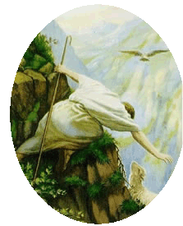
School – Home Preparation the Sacrament of Reconciliation For Parents/Carers
January 2024

Slide 2
Be still and know that I am god
Be still and know that I am God. (3)
I am the Lord that healeth thee. (3)
In thee, O Lord, I put my trust. (3)

Slide 3
Welcome and Prayer

Slide 4
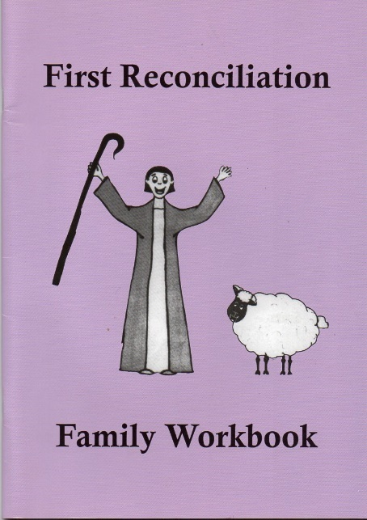
The WorkBook
Each child will have their own personal workbook.
There are 9 activity sessions, called ‘Home Sessions’ during which the parent or guardian will assist the child in completing the workbook.

Slide 5
Home session 1
Gift of creation.
Uniqueness of each child.
We are made in the image and likeness of God.
Discuss your child’s birth and early life.
Emphasis their good points.
“It was you who created my inmost self, and put me together in my mother’s womb, for all these mysteries, I thank you.”
Psalm 139

Slide 6
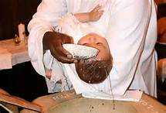
Home session 2
Family - Community – Church
We are called by name to live in friendship with others and with God.
Baptism and about their chosen name. How special they are.
Your child’s talents, gifts and favourite things.
“Do not be afraid, for I have redeemed you, I have called you by your name, you are mine.”
Isaiah 43:1

Slide 7
Home session 3
The Goodness of your Child
Children should be guided to think about people who are special in their lives.
Talk to your child about when they have been a good friend to others.
They have a chance to draw themselves with their friends and to write their name in the prayer.

Slide 8
Home session 4
Values of God’s Kingdom
A story from the Gospel of Matthew - Jesus taught us and showed us that he had a special love for children.
Jesus blessed children and those like children.
An opportunity to reflect on the story with your child and talk about their goodness and when you think they have shown goodness.
“Whoever becomes like a little child is the greatest in the Kingdom of Heaven.” Matt. 18:4

Slide 9
Home session 5
The Good Shepherd
We understand that God speaks to us through the Bible.
We learn of God’s love for us, even when we don’t make good choices.
Children learn about the parable of the “Good Shepherd.”
An opportunity to reflect on the parable and to think of a time when they felt lost.
“The sheep that belong to me listen to my voice, I know them and they follow me.“ John 10:27

Slide 10
Home session 6
Call to Forgiveness - Zacchaeus
Jesus called Zacchaeus and offered forgiveness.
Zacchaeus accepted forgiveness and wanted to make up for his wrong doing.
Children will learn that we should accept Jesus’ offer of forgiveness.
We should try to make up for the times we haven’t made good choices.
“For the Son of Man came to seek and to save the lost.”
Luke 19 :10

Slide 11
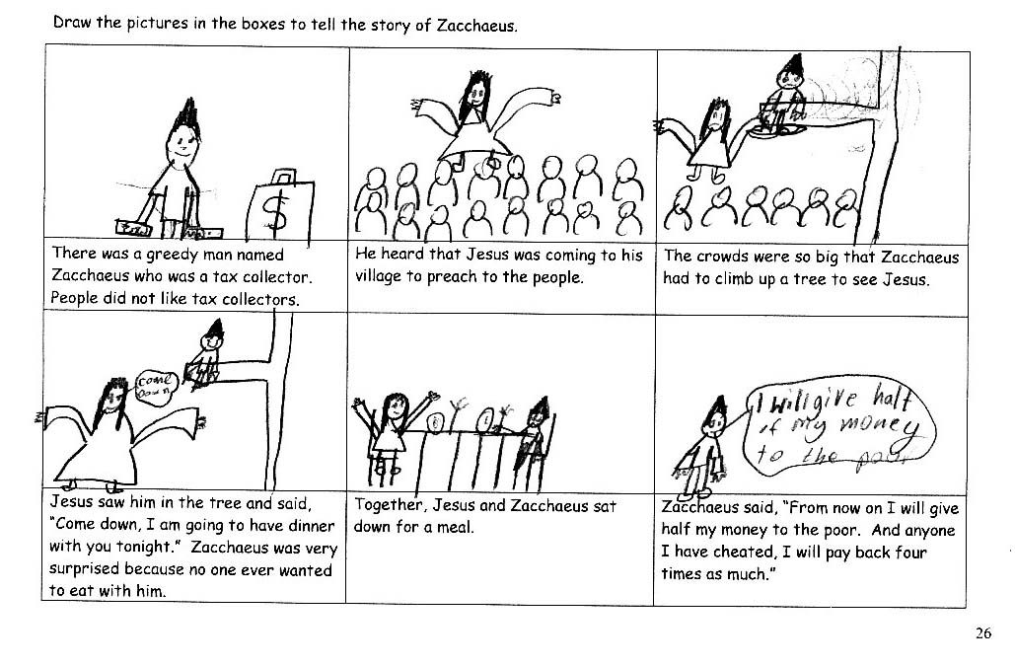
Home session - Activities
Storyboard

Slide 12
Home session 7
Examination of Conscience
Discuss with your child
times they have acted selfishly.
times they have hurt others.
saying sorry.
Ask for God’s help.
Parents remind children that they love them even when they do wrong.
God also loves us even when we do wrong and always forgives us.
Children are asked to think about times when they show their goodness.

Slide 13
Home session 8
True Meaning of Reconciliation- making up with others.
When we say sorry, we must mean it.
We will have
kind eyes
kind voice
kind heart
Child can draw and talk about a time they said sorry.
Adult tells child time when they said sorry.

Slide 14
Home session 9
Preparation for the Sacrament
God loves me unconditionally.
Jesus healed and forgave people through both gestures and words.
I can choose to accept God’s way in my life.
I have free will, so I can choose to turn away from God.
When I turn to God in sorrow for my sins, I can live in peace and friendship with others.
When I need to say sorry to God and to others, I can do it in my own words, in formal prayers and in services in the Church.
Home Session involves playing a simple game and a prayer time.

Slide 15
Prayer Time
In class, religious lessons end with a prayer time.
Each home session should end with the same format of prayer time.
Light the candle
Sign of the Cross
Read Bible verse to focus on the message of the session
Say prayer with your child
End with Sign of the Cross and a hug.

Slide 16
The Rite of Reconciliation
Kneel down and make the Sign of the Cross.
“Bless me Father for I have sinned. This is my First Confession.”
“These are my sins...”
Remember the penance the priest gives you.
Say the Act of Sorrow.
Make the Sign of the Cross as the priest gives you absolution.
Say “Thank you Father.”
Return to your place and say your penance.

Slide 17
The Act of Sorrow
O my God, I thank you for loving me.
I am sorry for all my sins,
For not loving others and not loving You.
Help me to live like Jesus and not sin again.
Amen.

Slide 18
Thank You

Slide 19
God forgave my sin
God forgave my sin in Jesus’ name.
I’ve been born again in Jesus’ name.
And in Jesus’ name I come to you
to share his love as He told me to.
He said: “Freely, freely you have received;
freely, freely give.
Go in my name, and because you believe,
others will know that I live.”

Slide 20
All pow’r is giv’n in Jesus’ name,
in earth and heav’n in Jesus’ name.
And in Jesus’ name I come to you
to share his pow’r as he told me to.
He said: “Freely, freely you have received;
freely, freely give.
Go in my name, and because you believe,
others will know that I live.”

Slide 21
Dates for FIRST Reconciliation
St Andrew’s Parish Church
Saturday 9 March 10-11am
St Joseph’s Parish Church
Thursday 14th March 7.30pm

