Slide 1
Do This in Memory of Me
Sacramental Preparation for First Holy Communion
Notes:
Welcome and Introduction
The aim of this session is to provide an overview of the classroom and parish materials which have been created to prepare the P4 pupils for the reception of the Sacrament of First Holy Communion and to outline the ways in which you can support your child through this period of preparation.

Slide 2
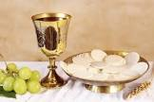
Gifts of bread and wine, gifts we’ve offered,
fruits of labour, fruits of love;
taken, offered, sanctified,
blessed and broken; words of one who died;
‘Take my body, take my saving blood.’
Gifts of bread and wine: Christ our Lord.
Christ our Saviour, living presence here
as he promised while on earth:
‘I am with you for all time,
I am with you in this bread and wine.’
‘Take my body, take my saving blood.’
Gifts of bread and wine: Christ our Lord.

Slide 3
Do This in Memory of Me
Sacramental Preparation for First Holy Communion
Notes:
Welcome and Introduction
The aim of this session is to provide an overview of the classroom and parish materials which have been created to prepare the P4 pupils for the reception of the Sacrament of First Holy Communion and to outline the ways in which you can support your child through this period of preparation.

Slide 4
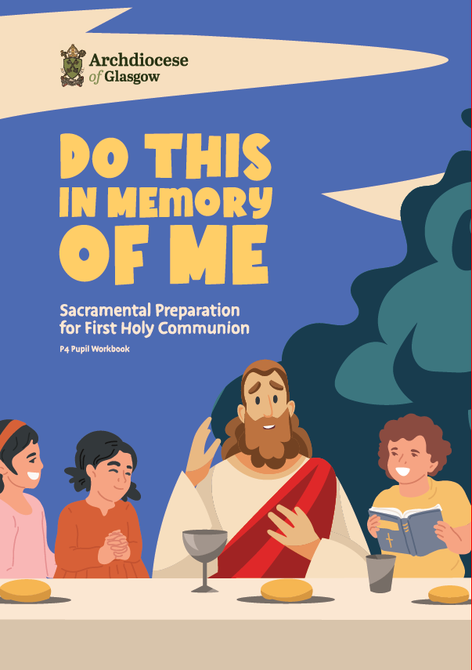
Aims:
to support sacramental preparation in the home, school and parish through the provision of high-quality resources
to ensure that pupils are prepared well and have a good understanding of the Eucharist and the Mass
to encourage reverence and participation in the Mass
Notes:
So first of all lets look at what we are aiming for with this new resource.
to support sacramental preparation in the home, school and parish through the provision of high-quality resources.
to ensure that pupils are prepared well to receive the Eucharist
to encourage reverence and participation in the Mass

Slide 5
Preparation Programme School:
School Lessons (approx. 6 weeks)
Additional learning about the Mass to be undertaken in term 1/2.
Eucharistic Adoration 4 sessions to be undertaken throughout the year prior to First Communion.
Notes:
So what resources are available to help schools, parishes and parents to work together to achieve this.
School Lessons
The materials for class teachers will guide the Religious Education programme in school during the period leading up to the celebration of the Sacrament of First Communion. It is anticipated that this period will be around 6 weeks in length and there are around 18 lessons in total.
The class lessons are rooted in prayer and scripture. Each lesson is either began or brought to a close through prayer and the pupils listen to and reflect on a variety of scripture passages. Art, drama and music are also widely used to bring the lessons to life for the pupils.
Additional learning about the Mass will be undertaken prior to the First Communion Lessons.
We are learning to understand Gestures, Learn Responses and Understand silences
Eucharistic Adoration 4 session to be undertaken throughout the year prior to First Communion.
We have already participated in one adoration session at Turnbull High School Earlier in the year and we have a further 3 planned prior to First Communion.

Slide 6
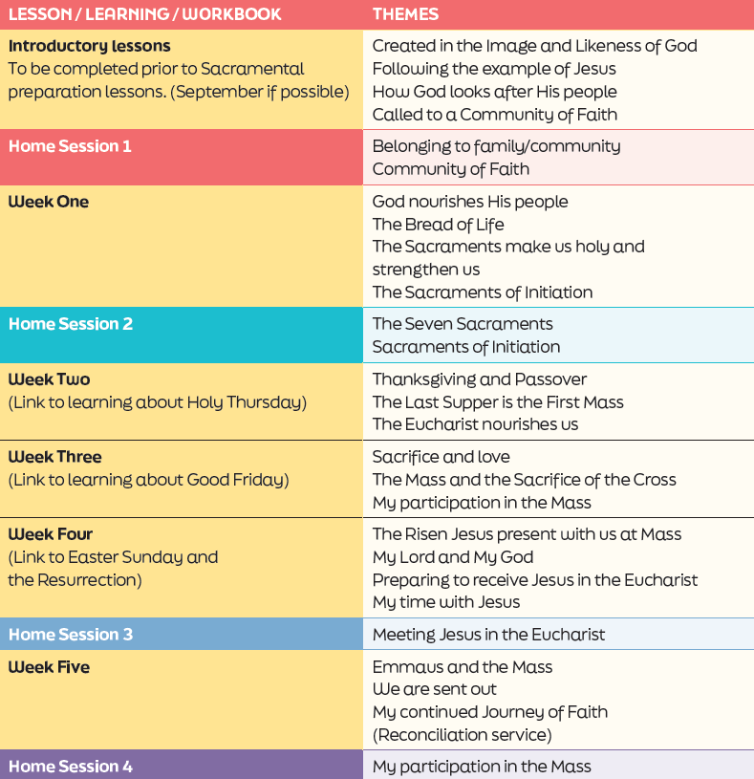
Notes:
I’ll provide you with a brief overview of themes covered in the school lessons:
There are three introductory lessons to prepare the pupils for the subsequent learning and the remaining lessons have been organised into 5 weeks anticipating that the teacher will complete approximately three lessons a week.
The lessons take a very interdisciplinary and connect to other aspects of the pupils’ learning in school.
In the introductory lessons the pupils explore what it means to be created in God’s image and how they might follow the example of Jesus in living a life of holiness. They reflect on Old Testament passages where God looked after His people and then think about it means to be part of a Community of Faith.
In Week One: the pupils learn that just as their bodies need certain things to be physically healthy so too do we need certain things to be ‘spiritually healthy’: prayer, the Sacraments, the Eucharist, Scripture. They then learn about the Seven Sacraments and the spiritual nourishment that we receive in the Eucharist.
The learning in weeks two, three and four link closely to what the pupils will be learning during Lent.
In Week Two: They explore the themes of Passover, Thanksgiving and that through the Mass we give thanks to God. Using drama techniques they recount what happened at the Last Supper and then learn about the links between the Last Supper and the Mass.
In Weeks Three and Four: The pupils learn about sacrifice and love and that just as the Risen Jesus was truly present with his disciples after His Resurrection He is also truly present with us at every Mass.
Finally in Week Five: the pupils learn about the Mass through the story of the disciples on the Road to Emmaus. They will also have the opportunity to receive the Sacrament of Reconciliation in school that week.

Slide 7
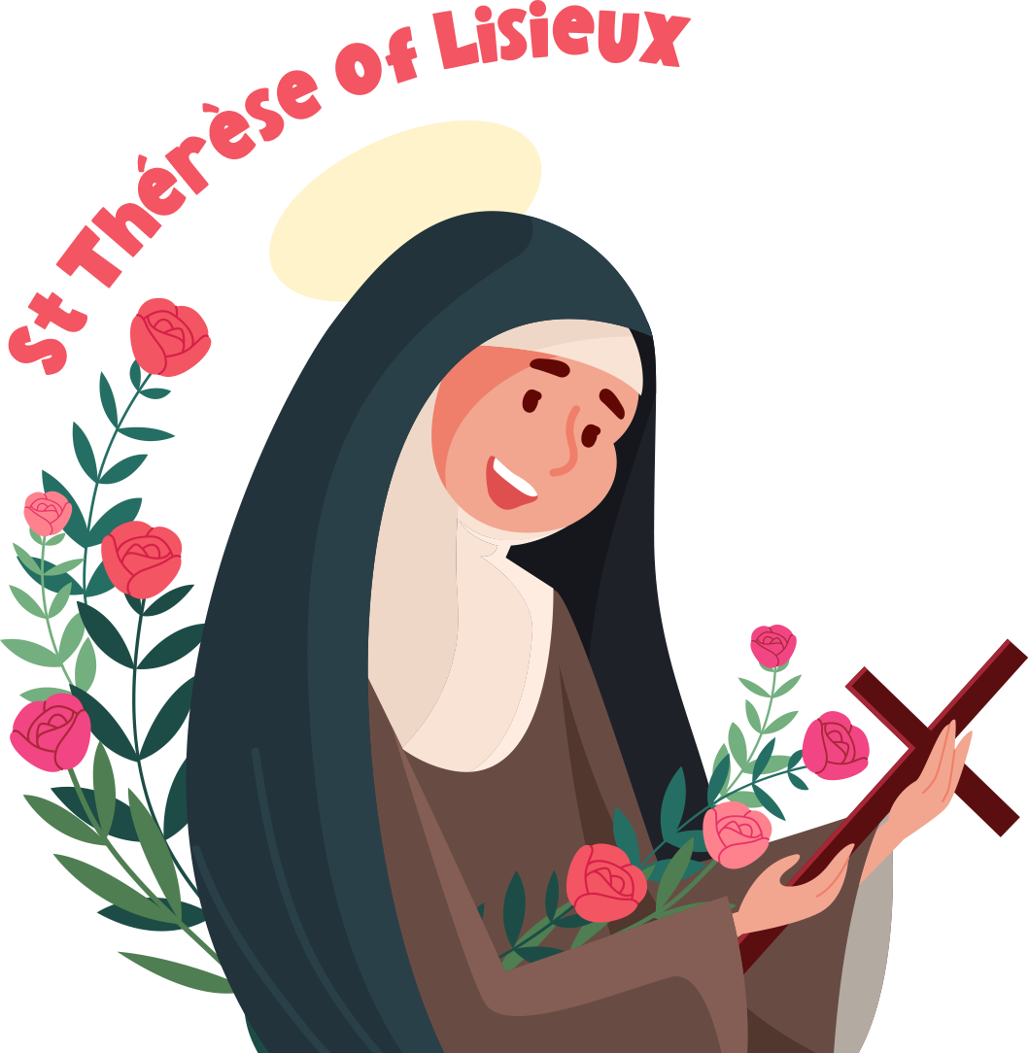
Weekly Saint’s Quotes
Questions from St Thérèse
St Thérèse’s Top Tips
St Thérèse’s Little Way
Adoration of the Blessed Sacrament
Notes:
St Therese of Lisieux is the patron of the programme. Throughout the lessons and workbook St Therese will ask the pupils questions and share ‘top tips’ for First Communion preparation and participation in the Mass. She will also introduce a quote from one of her friends the saints each week for the pupils to reflect on.
As a child Therese was desperate to receive Jesus in the Eucharist at her First Communion and prepared to do so in a special way, she loved to pray before Jesus in the Blessed Sacrament and her Little Way is an easy way for children to understand that the Mass doesn’t end in the Church that we are each called to live our faith and to go out and share the love of God with others.
St Therese’s Top Tips for First Communion Preparation:
Pray to Jesus every day asking Him to help you to prepare well for your First Holy Communion
Go to Mass every Sunday
Visit Jesus in the Blessed Sacrament/Adoration
Use my Little Way to show God’s love to others

Slide 8
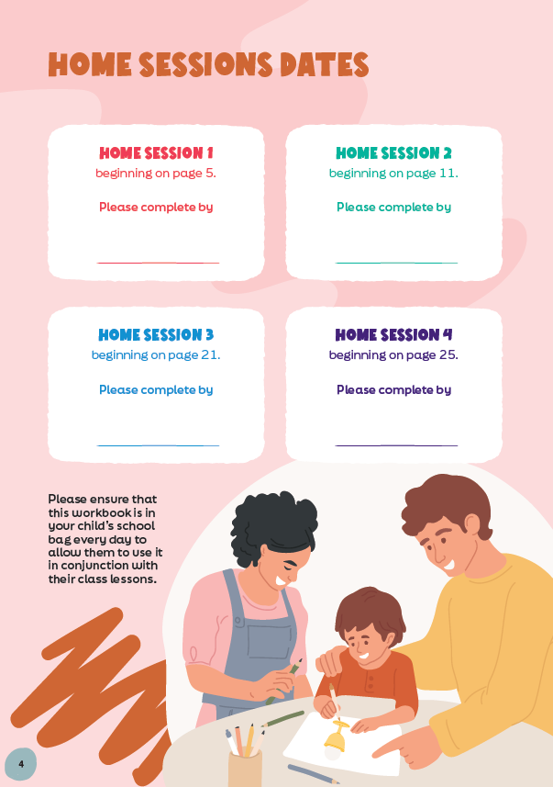
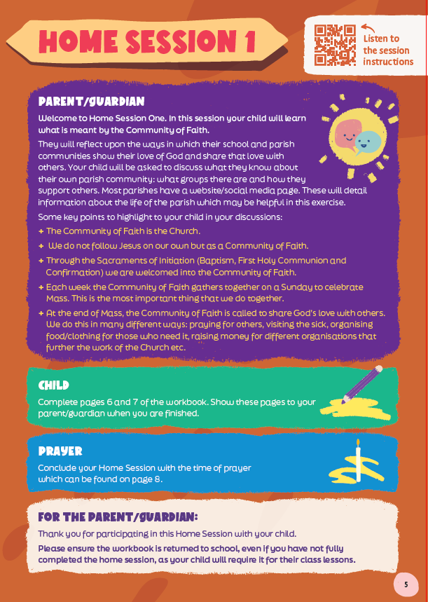
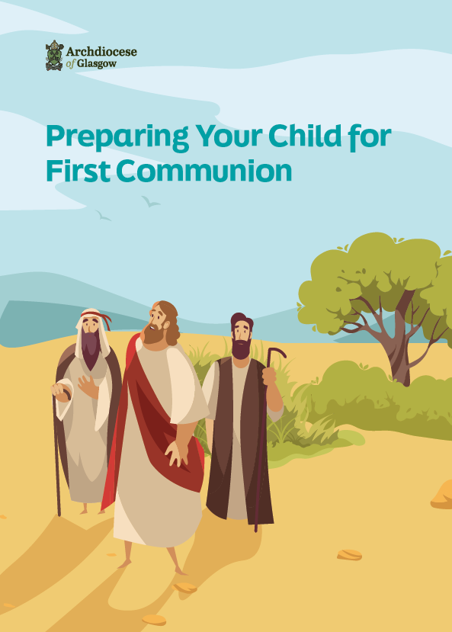
Notes:
Resources for Home:
Pupil workbook – 4 x Home Sessions
The pupil workbook has a combination of activities for class and home. There are 4 x Home Sessions in total. These reflect the learning that has been undertaken in class
When it is time to complete the Home Session I will send the workbook home and you will find the date by which it should be completed on pg4.
The notes for the parent/guardian outline what the child has been learning in school that week and guidance on completing the activities. Each Home Session includes a short time of prayer where you can light a candle, listen to a short piece of scripture and pray together. You may wish to involve other siblings in the time of prayer too.
You’ll see at the bottom of the page a note in bold asking that you ensure the pupils have their workbook with them in school every day (even if they have not fully completed the session) to allow them to complete their class activities.
If you would prefer to listen to the instructions for the Home Session, you can scan the QR Code at the top righthand corner.
The Archdiocese of Glasgow has produced a Parent handbook with information to help you accompany your child through the process. It includes: suggestions on how you can support your child at home, prayers that the children should be familiar with, links to resources and websites to support parents, the order of the Mass, additional reading etc.
These can be purchased by contacting the Archdiocese or your parish.

Slide 9
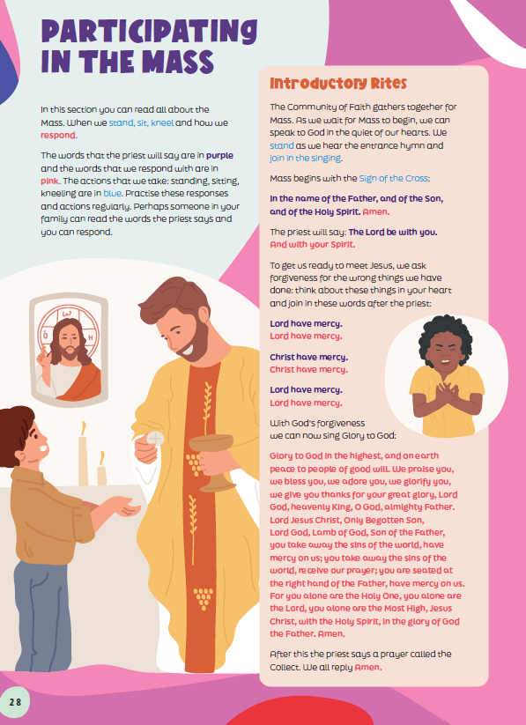
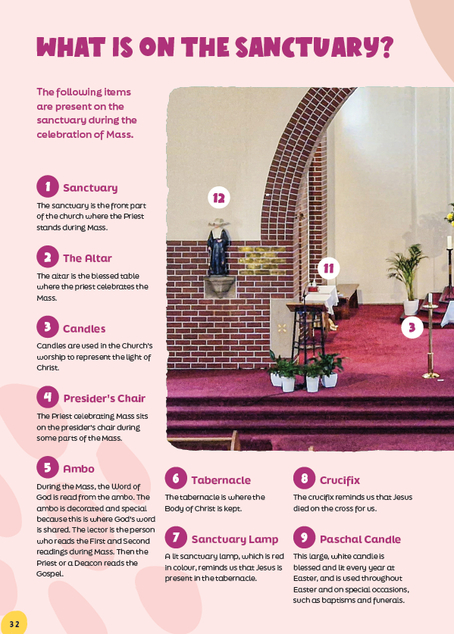
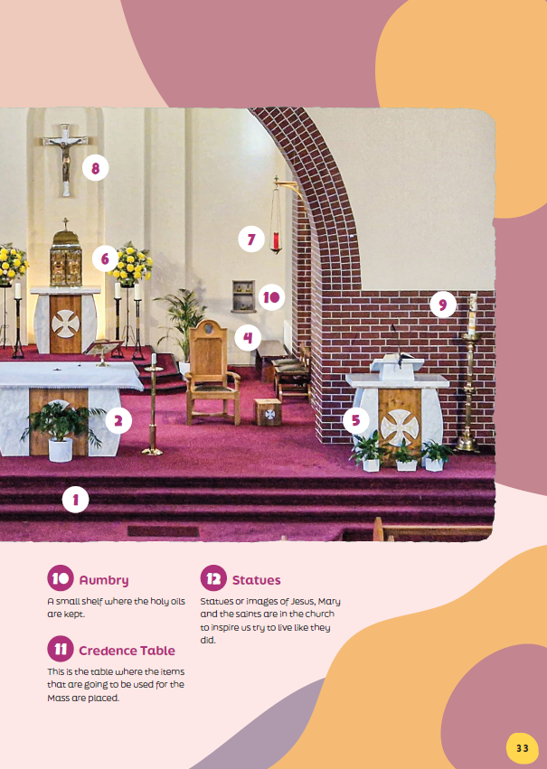
Notes:
At the back of the pupil workbook you will find additional resources which can be used to support your child.
‘Participating in the Mass’ section: explains what is happening at each part of the Mass and includes all of the Mass responses as well as information about when we sit, stand and kneel.
‘What's on the Sanctuary’ section: provides an overview of what you can see on the sanctuary in your church and explains its significance/purpose.
‘Glossary’: can be used by your child at home or in school to record new words that they have learned and what they mean.

Slide 10
This is My Body
This is my body,
broken for you,
bringing you wholeness,
making you free.
Take it and eat it,
and when you do,
do it in love for me.
Back to my Father,
soon I shall go.
Do not forget me;
then you will see.
I am still with you,
and you will know
you’re very close to me.

Slide 11
First Holy Communion Dates
St Andrew’s Parish Church
Sunday 19th May 12 Noon Mass
St Joseph’s Parish Church
Sunday 12th May 11.30aam Mass

