Slide 1
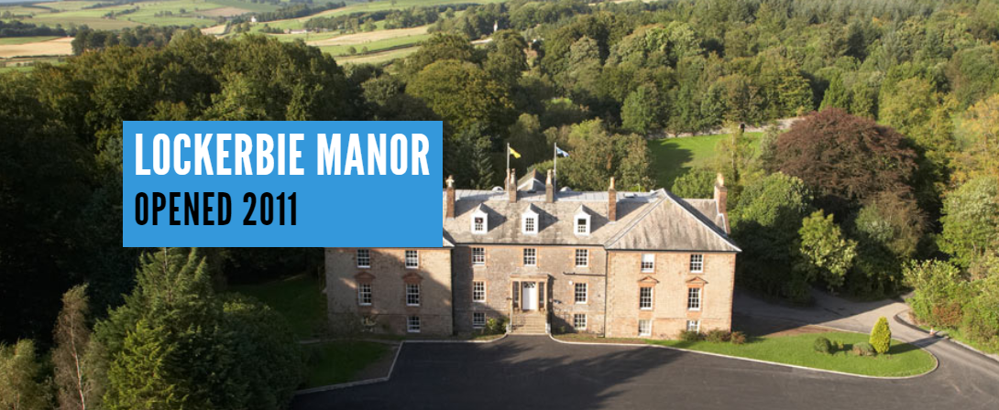

Slide 2
What do I need?
Children will be issued with a list of advised clothing
Children should bring a pillow with pillowcase / sleeping bag
No hair dryers or straighteners are permitted
No aerosols – deodorants etc.
Mobile phones and electronics are not permitted
Snacks are permitted but strictly no nuts
Money for tuck shop – optional. Limited to £10
Notes:
Nothing new or valuable, be prepared for clothing to get lost or ruined, must bring waterproofs
No hair dryers- no plugs in pods – good idea for girls if got long hair to plait or put up for first few days so that they don’t need to wash it
Hairdryers in shower block?
Tuckshop is not a shop! Sweets, juice and crisps. No need for any more than £10 – please bring in change. No need for vast amounts of food.

Slide 3
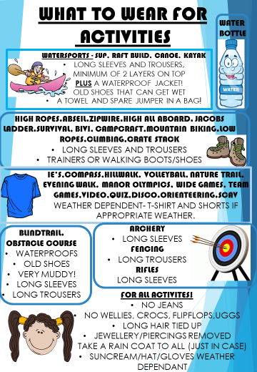
Notes:
Very helpful for the children, long sleeves are advised. Facticity have waterproofs or the children can bring their own.
No jeans for activities

Slide 4
Medication
All children requiring medication (daily or once off) should complete a medication form and return to the office prior to trip
Medication should be clearly labelled and instructions for administering clear.
Medications will be kept in an accessible place to adults but away from children.
Medication will be administered by an adult and logged.
Inhalers – children will require to have their inhalers on their person for activities for ease of use. Recommended to bring two inhalers if possible.
Notes:
This will include
Travel pills- still need to hand in and fill in form – please don’t put in bags/
any painkillers, even just in case

Slide 5
The Journey
Can start to gather in the hall from 9.05am
Leave from the school at 9.30am
Visit to New Lanark – Children will need a packed lunch – tour & Annie McLeod ride
Leave at 1.30pm
Estimated arrival at Lockerbie is 2.30pm
Children are asked not to bring any food or drink onto the bus
Travel sickness pills should be administered before the journey

Slide 6
Arrival
Arrive for 2.30pm
Pod allocations are given out
Tour and Fire Drill
First Activity – 3.30pm
Dinner – 6pm (Approximately)
Evening Activity – 7.15pm
Notes:
Children will be in a pod with at least one other pupil that they put on their list.

Slide 7
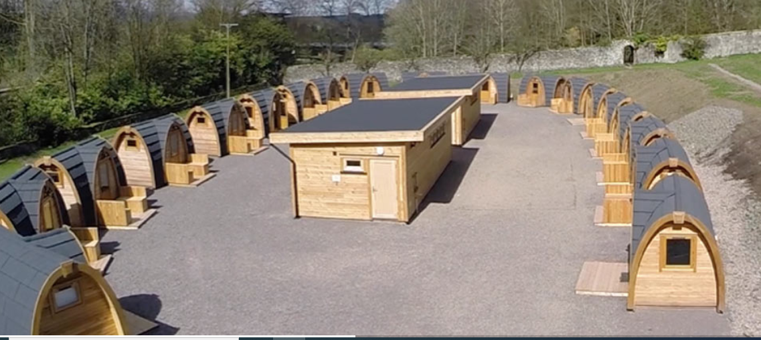
Accommodation
Notes:
Adults interspersed
Toilet/shower block in middle.
Sensory lights so if need to go to toilet during night – gravel!

Slide 8
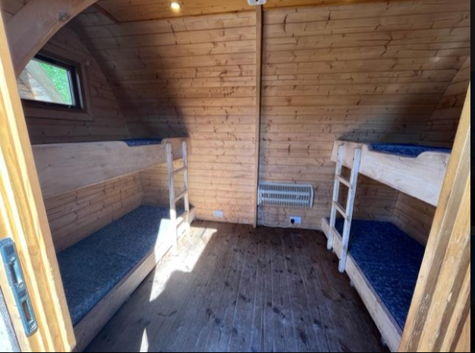
Accommodation

Slide 9
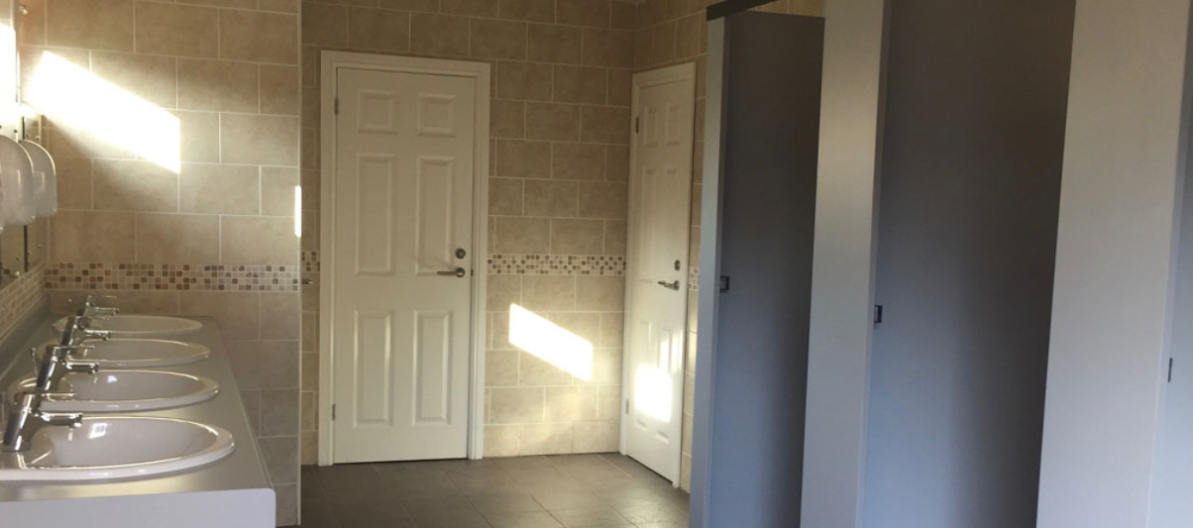
Notes:
Toilet blocks

Slide 10
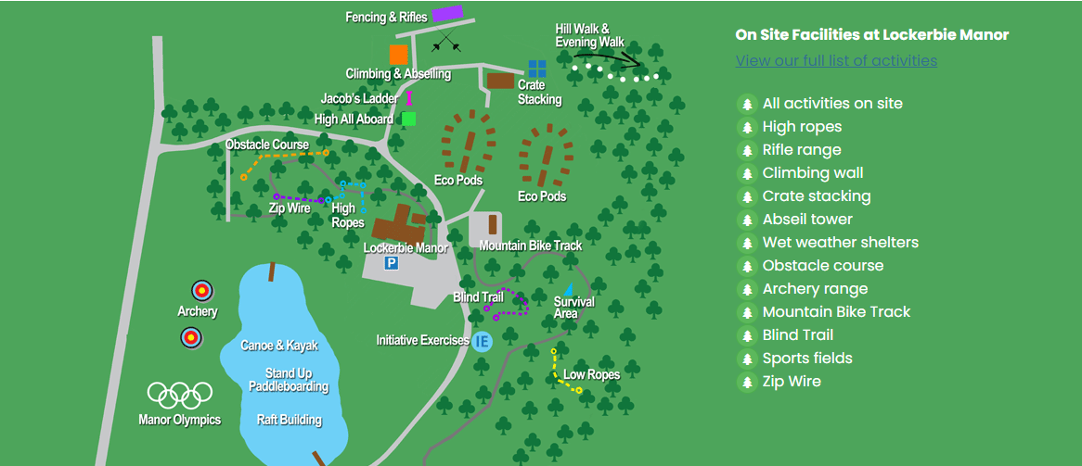
Site Map
Notes:
Everything on site, more than one school at a time, designated spots for each activity, Before activities – meet at car park, break off, some activates are completed as a whole group – team games or the walk

Slide 11
Activities
Children will be in larger activity groups for the week.
Nineteen outdoor pursuits – 4 throughout the day / 1 in the evening.
Groups do not have a set instructor – will work with a range of instructors throughout the week.
Health and safety is paramount – instructors are clear on this for participation.

Slide 12
What does a day look like?
School’s Discretion - Rise & Shine at 7.00am
Breakfast – 7.30 – 8.30am
09.15 – 10.30 - Outdoor Pursuit Session 1
10.30 – 10.55 - Break Time
10.55 – 12.20 - Outdoor Pursuit Session 2
12.20 – 13.45 - Lunch Time
13.45 – 15.10 - Outdoor Pursuit Session 3
15.10 – 15.35 - Break Time
15.35 – 17.00 - Outdoor Pursuit Session 4
17.15 – 19.00 - Evening Meal / Free time
19.05 – 20.30 - Outdoor Pursuit Session 5
Bedtime - At the discretion of the school
Notes:
In between each session is a short break time because the children will have to go back and get changed

Slide 13
Notes:
Sample of outdoor pursuits
If children don’t want to do particular activities
Appreciate that many of these activites they will be trying for first time and may be worried- they are encouraged and supported to give it a go, or try part – wont be forced to do anything they don’t want to – they will normally stay with group- watch, support and encourage others.
If cant ride a bike – they would stay with adult and practise

Slide 14
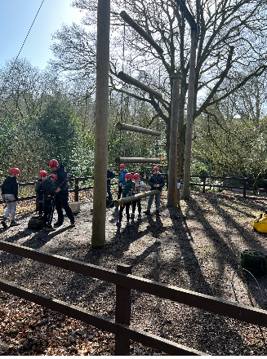
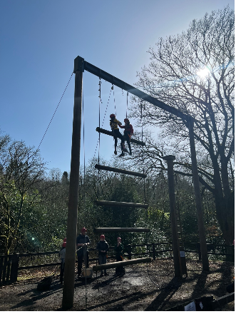
Notes:
Jacobs ;adder

Slide 15
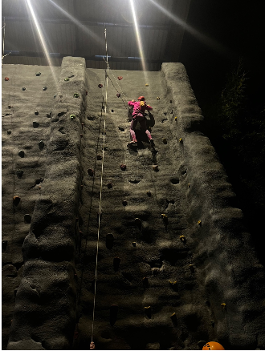

Slide 16
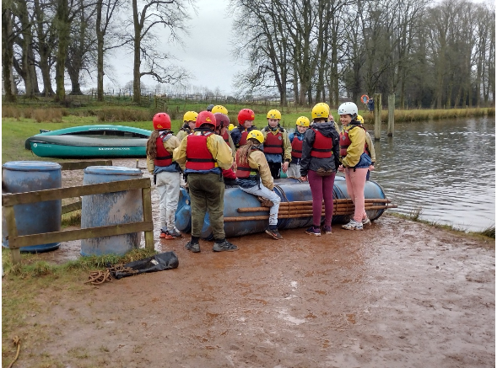
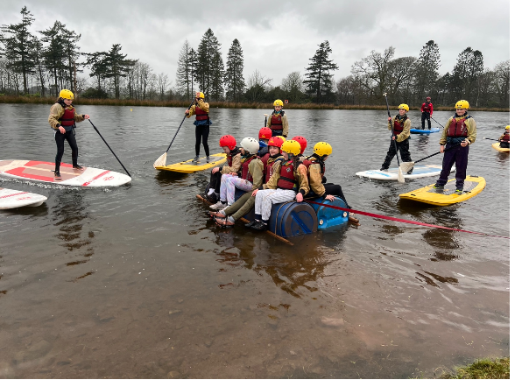

Slide 17
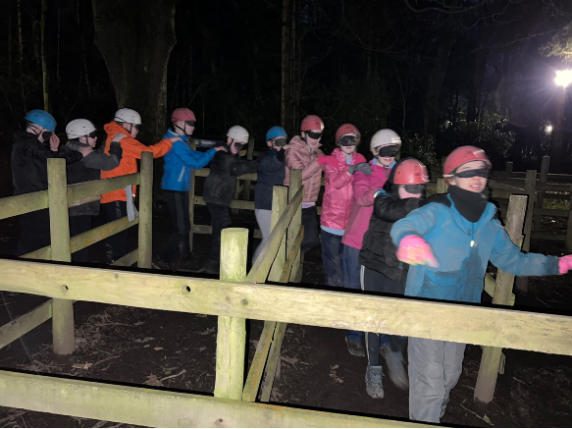

Slide 18
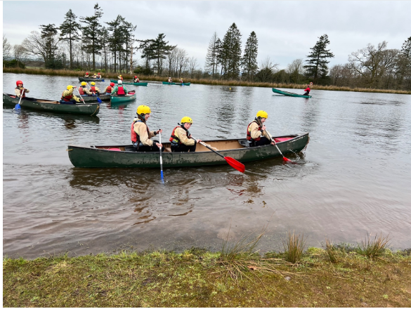

Slide 21
Food
Notes:
Cooked breakfast
Choice of a cold or hot lunch
Main meal – several options
Vegetarian, Halal, vegan and special diets catered for. Facility is a no nut establishment.
Birthdays- *** no birthdays this year **
let us know if birthday- parents can hand in a cake if no nuts and we can give it out after dinner.

Slide 22
Keeping you Updated
Lockerbie See-saw Page
School Website
School Office
(Staff will update regularly – Wifi permitting)
Notes:
We will keep you updated via
If we need to contact you – through school office or if outwith .. Mobile
What I would ask is for your patience and understanding re our updates – we know you are keen to see photos of how they are getting on-and staff will take lots of photos during the day
Biggest issue with updating Seesaw is the wifi- which is extremely poor!
Also some networks have better coverage than others – staff can feel pressured when one group has photos on and others don’t- staff can have been trying to upload for an hour an nothing is uploading- then it is time for their next activity – busy day/evening on duty and call 24/7
There also may be occasions when staff cant upload for day – (can give example) wellbeing of children will always trump the photo sharing! – will upload when get a chance
So please have patience and try not to call school if your child is not in a picture that day – staff are trying their best to make sure your child is having the best experience.
Also we will be short of office staff for part of this week because RM going – to ensure the trip can

Slide 23
Coming Home
Children requiring travel medication will receive this before commencing the journey.
Leave Lockerbie after lunch on final day.
School office will keep you updated on our estimated arrival time.

